Slide 1
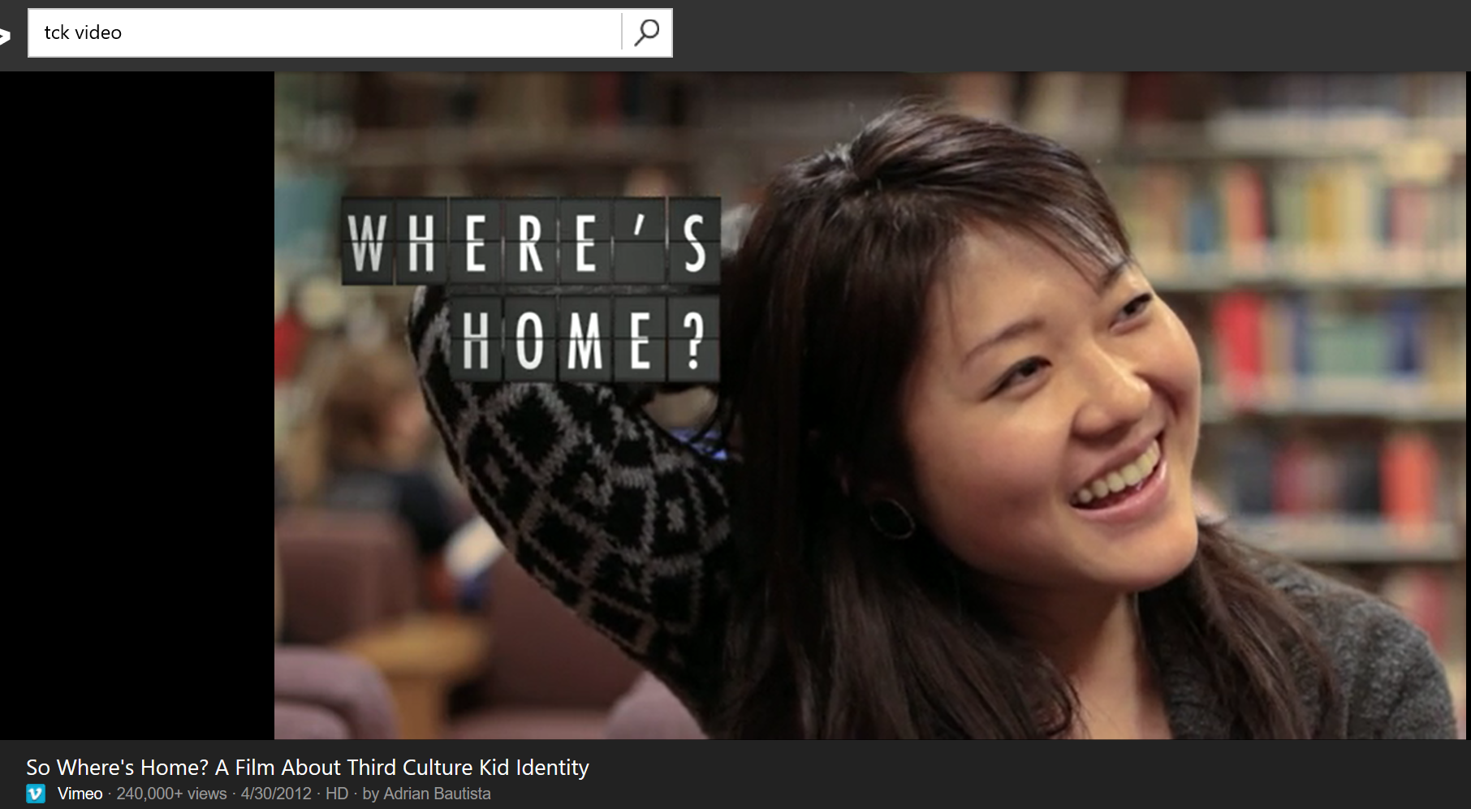
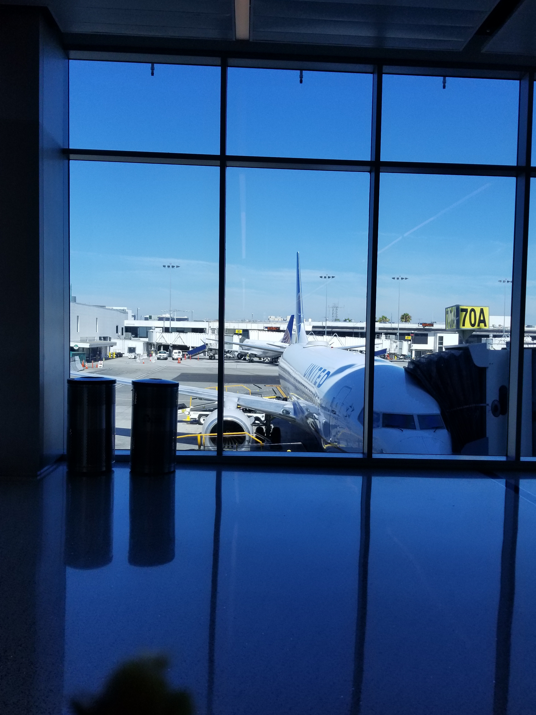
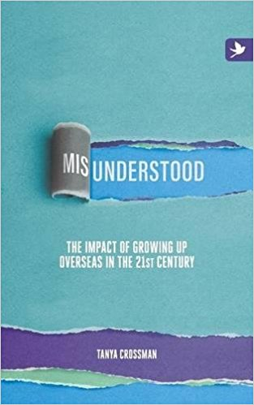
Understanding a diverse population: Third Culture Kids – Part One
How prepared are we to embrace this new
‘Third-culture-world’?
Prepared by Esther Tan
6th November 2019

Slide 2
Overview
Why is it important?
Who is a TCK?
Characteristics of TCK Experience
What does transition do to us?
Overview:
Gifts & Challenges of TCKs
Highlight issue:
Transitions & ‘hidden losses’
Unresolved grief
How can we support TCKs?
Inserted request:
My Transition Story: TCA

Slide 3
Are TCKs prototype citizens of the future?
tckid.com
Ted Ward (1984)
Why is it important for us?
With globalisation and technological advances, there is a sharp increase in the number of people travelling, working and living cross-culturally.
This highly-mobile, multi-cultural group has unique, emergent psychosocial developmental trajectories, and potentially could be the
prototype citizens of the future.
Notes:
Let’s consider, shall we, the TCK population…and apply our concepts of marginalization, play around and see if TCKs could be classified under this category…But first of all, for benefit of those who have not come across the acronym and help all of us to be on the same page, let’s first look at what is a TCKs…so that we can then have a good engagement with the topic on marginlization…
[30 sec]
Let me show you a short extract of a video here pls, to provide a quick sense of who TCKs are…… [1min]
https://vimeo.com/40853220
Long version:
https://vimeo.com/41264088?from=outro-embed

Slide 4
Emerging Trends in Globalization
Do we have
a competitive edge over others?
21st century workforce = multi-cultural workforce
Do we have what it takes to be a good clinician, social worker, people-helper?
75% of all international ventures fail due to cross-cultural issues
Up to 50% of all expatriates international assignments end prematurely, costing US organizations between $250,000 and 1.2 million each time. The collateral damage inflicted on customer relationships, credibility and profit is beyond estimate.
40% of multinational teams fail to attain their objectives because they fail to grasp cultural intricacies or their families could not adapt to cultural changes in the host country.
An undisclosed figure of corporate training programs delivered to multinational employees across foreign branches fail to achieve the expected results.

Slide 5
Definitions: 1950s…1976…2001…
Ruth Hill Useem coined the term “Third Culture Kid” (TCK) (Pollock & Van Reken, 2001, p. 20)
Definition was later adapted by Ruth Van Reken:
A TCK is a person who has spent a significant part of his or her developmental years outside the parents’ culture. The TCK builds relationships to all of the cultures, while not having full ownership in any. Although elements from each culture are assimilated into the TCK’s life experience, the sense of belonging is in relationship to others of similar background.
(Pollock & Van Reken, 2009, p.13)
Dr. Ann Baker Cottrell
Dr. Ruth Van Reken

Slide 6
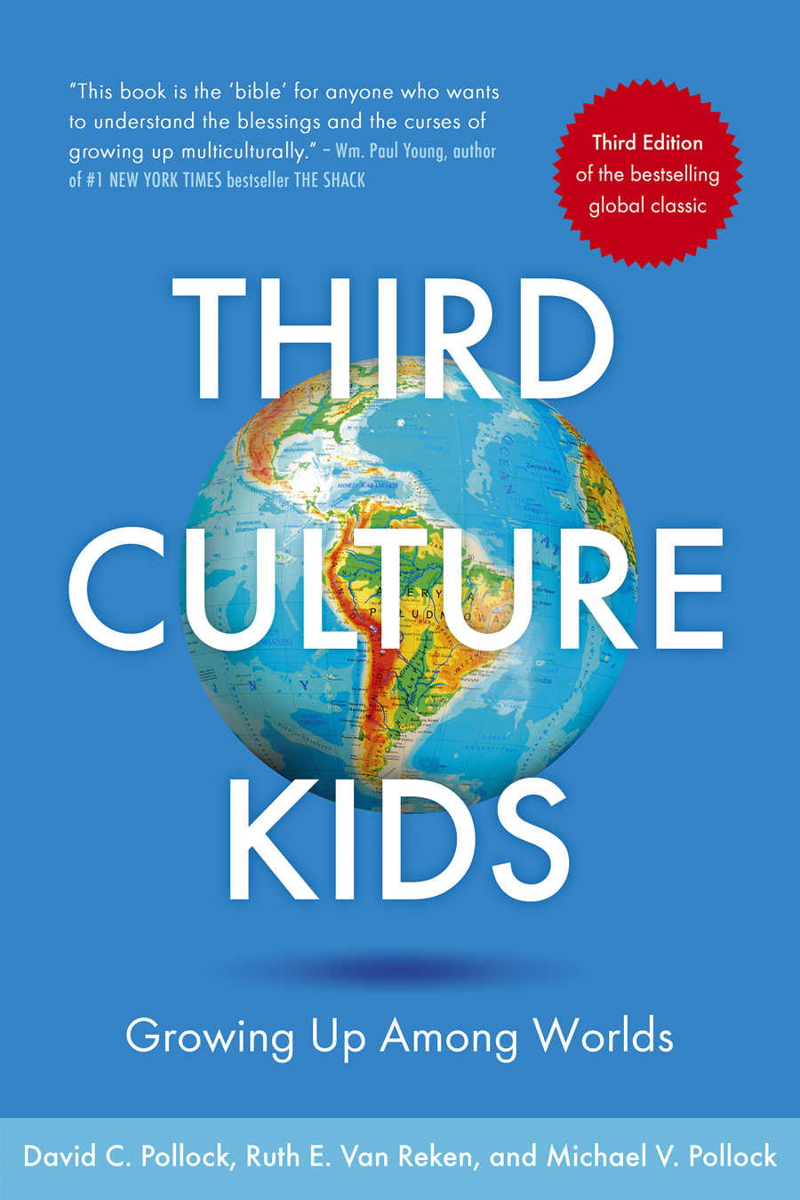
For discussion today: Who are Third Culture Kids & Third Culture Adults?
An Emergent
3rd Culture
A newly-formed interstitial culture;
an in-between home and host cultures.
A neither/nor world
2nd culture
Host Cultures moved to
Cultures lived in
Egs. America, Nigeria Switzerland, Greece, India, etc)
1st Culture
Home Culture
(Parents’ Culture
Egs. Korea, Japan, Singapore, China, Vietnam)
TCKs: those who navigated significant cross-cultural transitions different from home culture, before 18 yrs old, as children or teens
(adult TCKs – those who moved younger as TCKs but are now older than 18)
TCAs: those who navigated significant cross-cultural transitions different from home culture,
after 18 yrs old, as adults
Third Culture Kids-Growing Up Among Worlds
by David C. Pollock, Ruth E. Van Reken, and Michael V. Pollock.
Notes:
1 min

Slide 7
Military kids
Business kids
Missionary kids
Others
Inter-government agencies, educators,
students in advanced degrees
(42% are abroad for 1-2 years and 70% for less than 5.)
Third culture kids, Adult TCKs,
Global nomads, Sojourners, Cross-cultural kids, Internationally mobile, children of international students…etc
Some who go back and forth….

Slide 8
Cross-Cultural Kids
Third Culture Kids-Growing Up Among Worlds
by David C. Pollock, Ruth E. Van Reken, and Michael V. Pollock.

Slide 9
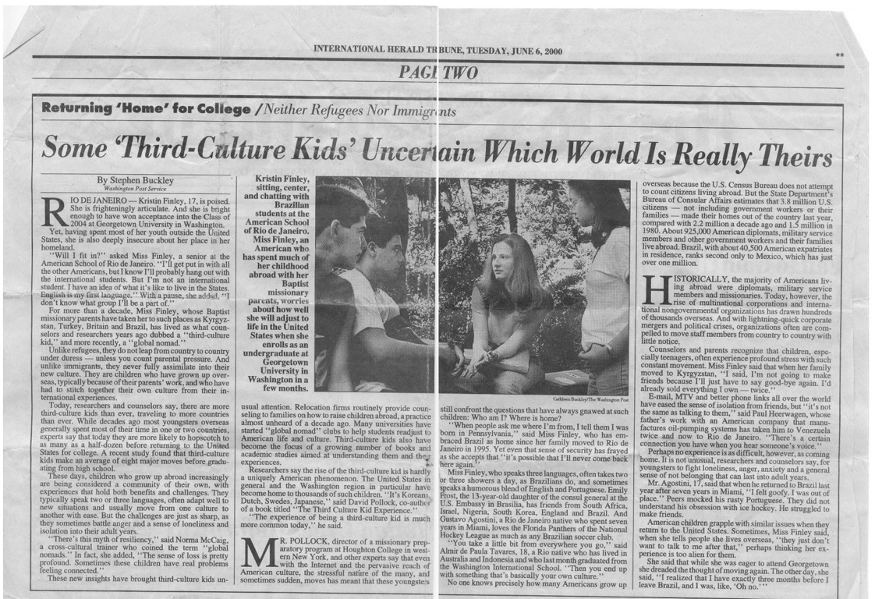
High Mobility
High Cultural exposure
Multilingual
International Herald Tribune, New York Times, June 6, 2000

Slide 10
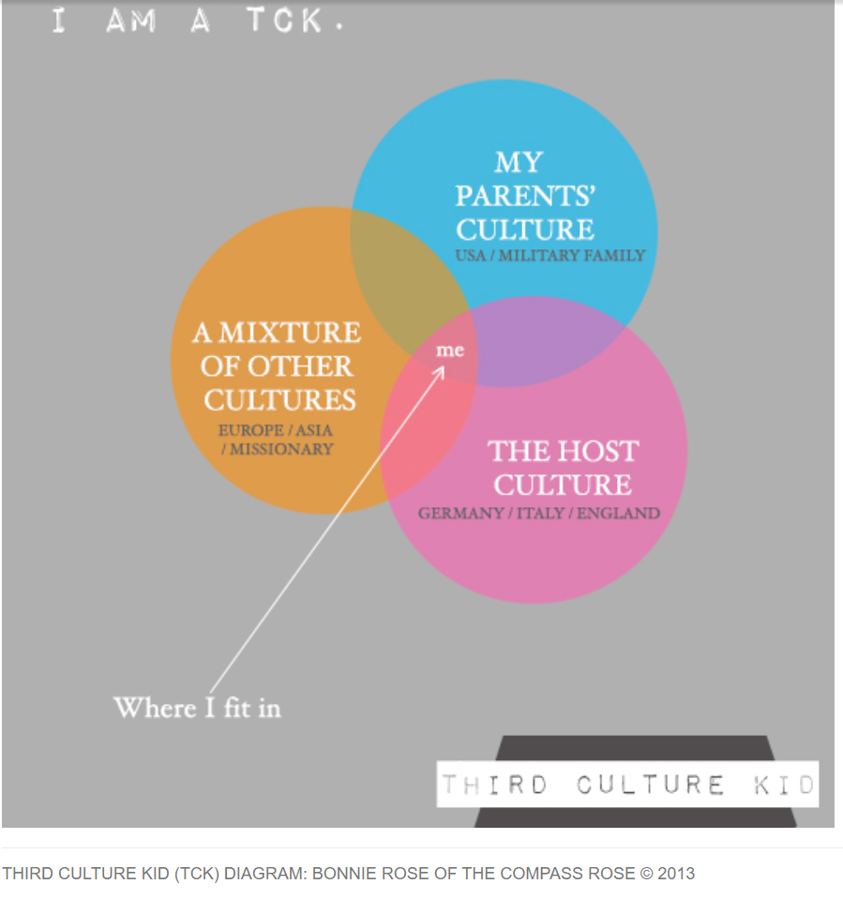
http://bonnieroseblog.co.uk/category/third-culture-kids/page/3
Shared from Bonnie’s blog with permission
Notes:
Bonnie…
This is the list of cities/countries she has lived in… Bath, London, France, Usa, Australia, Cambodia, Italy, Thailand, Japan…Germany…and etc…
So she drew her parents’ culture as the culture of USA, and of military family…
She drew Europe as the country she is living in now, a mix of germany, Italy and England…
And she also was a missionary kid experiencing a range of Asian cultures…. In a recent research study I did, out of 131 ppl surveyed, I have the highest number of cities lived in for at least two years, being …
So the question they often ask themselves is: which culture do they really belong? More blue, or pink or orange circles? Neither of them…she feels she is right smeck in the intersection of all….. That’s her..
So TCKs really felt most at home, at the interstitial/intersection/in-between cultural point.. Hence, when you ask them, where do you come from? Where do you most identify with?

Slide 11
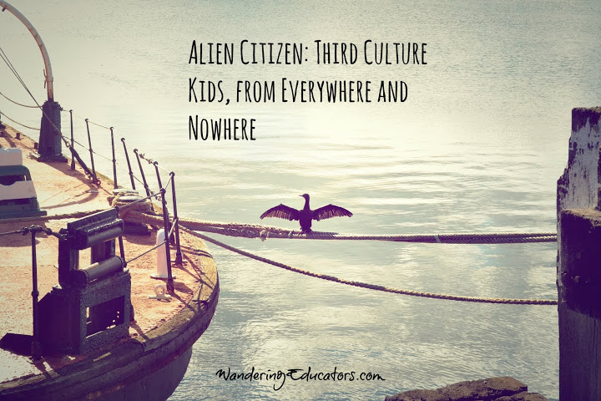
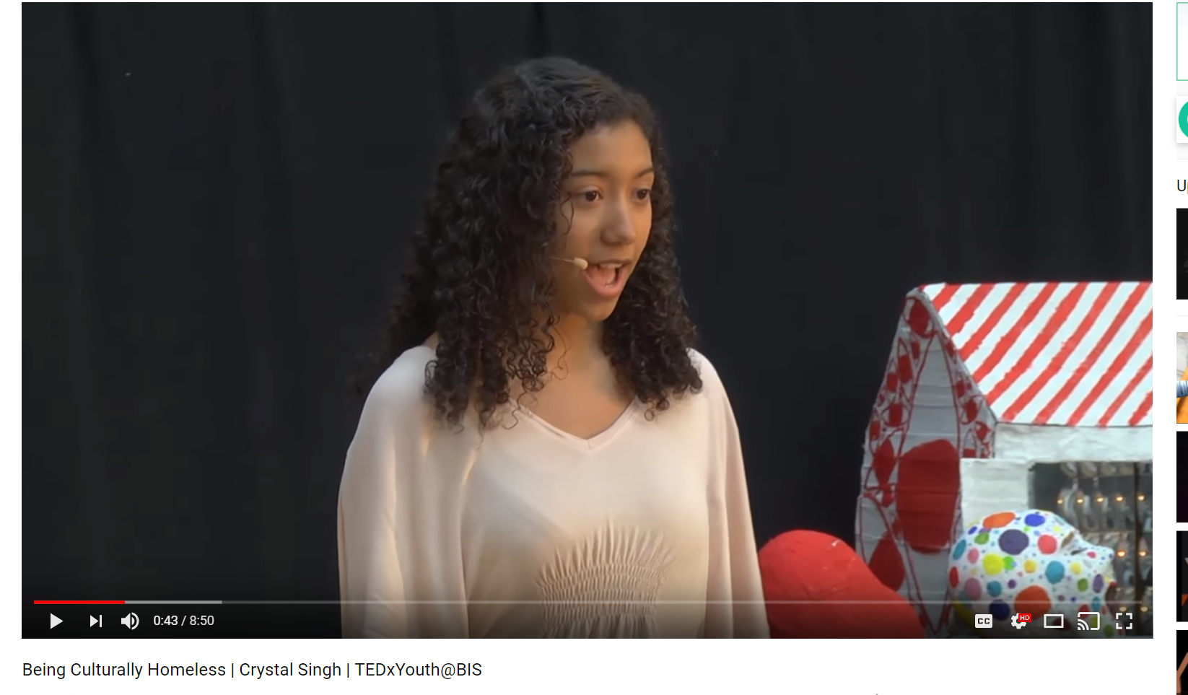
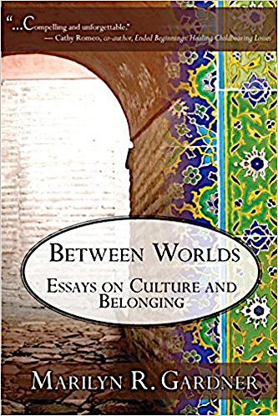
Notes:
These are the books that have ben written that describes TCKs… Let’s look at some of these descriptions…
- “ Alien citizen…” “ From everywhere and nowhere” what does this sound like? Does it sound like a homeless person?
- Strangers at home…. They are home? Yet they feel like a stranger…are they at home then?
- Misunderstood….
- Between worlds… are they constantly in-betweens… so is their home an in-between world too?
Interestingly, I came across a TED talk by Crystal Singh, a teenager who was born in United States, has lived in Singapore, Europe and has since moved back to the States… She termed her TED Talk – “Being Culturally homeless..”
Something I’ve never come across before…she identifies herself as a TCK and defines that TCKs are “culturally homeless”….
I guess, most of us would be able to say the homeless community (in the normal use of the word), as a community that is a mariginalized group.. And they have many needs that community psychologists can bring to them.
“What about the culturally homeless?” This seemed abstract, intangible… they have a physical home, but which they don’t feel at home in… they are constantly trying to figure out and to build a home for themselves that they can fit in and feel comfortable… So, my question in reflection is - have we or would we extend the same helping hand to this homeless population? Why yes or why no? Perhaps, this hinges on our belief and definition bout marginalization.
[1 min..]
Let’s put side by side, what marginalization entails, and look at the illustration from a CASE Study of an Adult TCK, and look at this whole issue through his lens and experience…

Slide 12
Sharing from a classmate…

Slide 13
Video: So Where’s Home? A Film about Third Culture Kids Identity
Teaser version: https://vimeo.com/40853220
https://vimeo.com/41264088?from=outro-embed
What are the gifts and struggles of TCKs?

Slide 14
Reflection Questions
What have you gleaned of the challenges of TCKs?
What are their gifts?
Which aspects of a TCK experience could you personally identify with?
Notes:
1 min, if we have music that’s great…
1 min to introduce and go back to earlier slide and stay there
To Isabelle, Then cue Danau and jane to get ready…

Slide 15
Wherever I am, I felt like I don’t fit in… don’t integrate fully…
I felt like a new immigrant…
An interview with a TCK
“Hidden losses”
“Left out”
Like an “outsider”
Everywhere I go, I know it is temporary…
I don’t know the pop culture, music, celebrities, TV shows…to even have casual conversations.. Sometimes I don’t care about those things too…
Not fully fitting in anywhere
“Hidden immigrant”
“Hidden foreigner”
“Hidden” Trauma
Separations from parents in boarding schools:-
unresolved trauma experiences
compounded grief & loss
I didn’t like Germany, my home culture. But when I came to US, I realized that I don’t like it either …. I need to keep moving…
Notes:
First, do you think TCKs are marginalized?
He immediately shared, yes , for example, I felt similar to the new immigrants…
I felt left out, like an outsider in the cultures,… even when I am here in the states, I do not watch enough pop culture to know what the classes talk about sometimes, whenever they bring in movies, and TVs and TV stars….
Does not know how to navigate each culture, …
I don’t like Germany, my home culture. But when I came to US, I don’t it either …. Wherever I am, I want to move somewhere and think other places are better…
Worries about transferability of educational qualitfications
- And Saying goodbye to parent was really hard. HE remembers the day when he went to boarding school at 6,
Trauma of separation from family at 6, has a lifelong impact
Many TCKs or MKs were separted from family….at young age…the impact of the relational trauma is lifelong…compared to a single-event trauma…
He shared experiences as a “hidden immigrant” and a culturally homeless”

Slide 16
Challenges
Where is home? (1-3min; 7:45-8:55)
Confused: looks, accent, name, family, multilingual(3-4min)
Never truly fit in anywhere
A ‘Temporary’ life…
Rootlessness and Restlessness – identity
Constant hi-byes
Loneliness and Isolation
Trouble with Intimacy
‘Delayed adolescence’
Hidden losses, Unresolved Grief
Chameleon - is there a ‘real’ me?
Notes:
Use chalkboard

Slide 17
Our gain is also our pain A silenced story…
Challenges
Confused identity
Identity crisis/Fragmented selves?
Too sensitive?
Too adaptable?
Restlessness, rootlessness
Fear of losing, pain of leaving; Unresolved grief
“Privileged?”
No language to articulate their losses…
‘Hidden losses’
Gifts & Talents
Multi-cultural, enjoys multiple cultural foods, festives, etc..
Able to perceive of different beliefs & values
High cultural intelligence; bridge gaps in cultures
Global awareness, code-switching
Social Capital
Creative, adaptable, Open-minded
Multilingual
“Privileged”

Slide 18
Literature Background
As part of their coping mechanism, they form functionally-connected friendships rather than emotionally-connected ones (Choi, 2013).
Some may try to mask their differences or remain silent about their past cross-national experiences, to fit in (Gillies, 1998).
Social Disconnectedness
(social connectedness)
Facing multiple moves filled with grief and losses, their sense of meaning and purpose in life are also being challenged by a multiplicity of worldviews (Pollock et al., 2017)
Constantly bombarded by exposure to varied and contrasting world views on relationships, issues of safety and trust, or existential questions such as the meaning of life.
Sense of Meaning and multiplicity of worldviews
Notes:
Explain more how that will look like? Emotionally-connected – not just with a temporal mindset….for school work purposes, only some hangouts…but someone u really enjoy sharing being together, growing togehtrer…more lasting..
Deep friendships…. Anni’e story – how do I date?how do I form a lasting relationship? What do I do?

Slide 19
Literature Background
Misunderstood
Mis-fit
Identity crisis
Cultural homelessness
With re-entry, lack of knowledge of home culture, different preferences about food, music, hobbies, worldviews. Hence, they may feel isolated, lonely, unaccepted by their peers.
(Pollock & Van Reken, 2001; Smith Kearney, 2016)
Adults have more fully formed senses of identity while children are still forming theirs (Erikson, 1959).
Always feeling inadequate or striving to fit in;
Maladaptive Perfectionists?
Constantly striving to fit in yet not being able to fully fit in. (Almost Perfect Scale; (Slaney, Mobley, Trippi, Ashby, & Johnson, 1996)
They have high expectations and standards as they are sensitive to what fits and do not fit, however, feel inadequate in meeting them. (Tan, Master’s Thesis, 2019; Wang)

Slide 20
Literature Background
Past literature has highlighted significant identity and socio-emotional issues faced by TCKs (Cranston, 2017; Davis, et. al., 2010; Davis, Suarez, Crawford, & Rehfuss, 2013; Moore & Barker, 2012; Smith, & Kearney; 2016)
.
The issue of encountering grief from losses due to multiple moves significantly affects one’s psychological well-being (Klemens & Bikos, 2009).
Social-emotional issues
The lack of having good closures has led to unresolved grief which is compounded for TCKs due to the multiple occurrences (Gilbert, 2008; D. Pollock, Van Reken, & M. Pollock, 2017).
Hu (2015) described the concept of unresolved grief due to the hidden losses in the life of a typical TCK, as the most poignant concept in Pollock and Van Reken’s (2009) book
Grief and Loss
Unresolved grief and closures
Notes:
Explain more how that will look like? Emotionally-connected – not just with a temporal mindset….for school work purposes, only some hangouts…but someone u really enjoy sharing being together, growing togehtrer…more lasting..
Deep friendships…. Anni’e story – how do I date?how do I form a lasting relationship? What do I do?

Slide 21
Literature Background
IS this needed?
Challenging TCK Experiences that Affect Social-Emotional Outcomes
refer to both recognized and unrecognized losses that did not receive healing from proper mourning (Pollock & Van Reken, 2011).
Hidden losses
Unresolved Grief
“With every transition, there is loss, even when there is ultimate gain. No matter how much we anticipate the future as good, we almost always leave something of value behind as well.
In loss, there is grief.” (Pollock & Van Reken, p.74, 2001)
Losses relate to the meaning attached to various aspects of themselves such that the experience of hidden losses are unique to each TCK… (Pollock et al., 2017)
Notes:
My professional identity loss…
Friendships -

Slide 22
What can we do then?
Acknowledge the losses, be patient with both for TCKs & TCAs
Identify the losses, give permission to articulate the losses experienced
Find/provide safe spaces to process them
Being embracing of the grief of what has changed…
Coping strategies, resources and support network
Be resourceful, reach out
Notes:
30 sec

Slide 23
Applications: What can we do? In our capacity as therapists, social workers, program directors at individual and systemic levels
Share with a partner: a) One thing you can do in the coming week,
b) One thing you can do in future,
to support TCKs?
Notes:
30 sec. literature…

Slide 24
Resources
The Encyclopedic book:
Third Culture Kids: Growing Up Among Worlds, 3rd edition. https://www.amazon.com/Third-Culture-Kids-3rd-Growing/dp/1473657660/ref=sr_1_1?ie=UTF8&qid=1505496203&sr=8-1&keywords=third+culture+kids
Letters Never Sent, updated, 2012, by Summertime Publishing https://www.expatbookshop.com/book/letters-never-sent
www.twitter.com/rdvanreken
My (newly-developed) website: TCKliminal.com
Conference Resource: Families In Global Transition (FIGT) Conference 2020: https://www.figt.org/;
https://www.tcktraining.com/blog/bringing-your-tcks-hidden-losses-out-of-hiding
Facebook groups: TCKs everywhere, Families in Global Transition
www.crossculturalkid.org
www.pinterest.com/amp/heidinindi/tcks-resources-for-third-culture-kids/
More about six different styles of coping strategies: BASIC pH (acronym) is a nice model that Singapore MOE uses, learning from an Israeli center: https://www.lcps.org/cms/lib4/VA01000195/Centricity/Domain/8931/HOW%20CHILDREN%20COPE.pdf
Thank you!
esther.tan@post.harvard.edu,
Notes:
30 seconds – 1 min
Some resources, encourage to reach out to those you sense need some resources, be that trusted friend. Just by having someone , a safe space is huge…reach out…interested coping strategies, go to the link , or you can email me…I would be setting up a website, puts in some research made layman, short videos with Ruth…let me know and I can email you when it becomes live in a couple of weeks…

