Slide 1
A webinar discussion on mobile lifestyle experiences What are ‘hidden losses’ in our lives?
With globalisation and technological advances, there is a sharp increase in the number of people travelling, working and living cross-culturally. This highly-mobile, multi-cultural group has unique, emergent psychosocial developmental trajectories, and potentially could be the prototype citizens of the future.
How prepared are we to embrace this new ‘Third-culture-world’?
Prepared by Esther Tan & the TCKs of Asia Group
Date: 24th August 2019
Notes:
1 min
Introduce before this.

Slide 2
What are hidden losses? Why are they important ? What can we do about them?
Notes:
10 sec

Slide 3
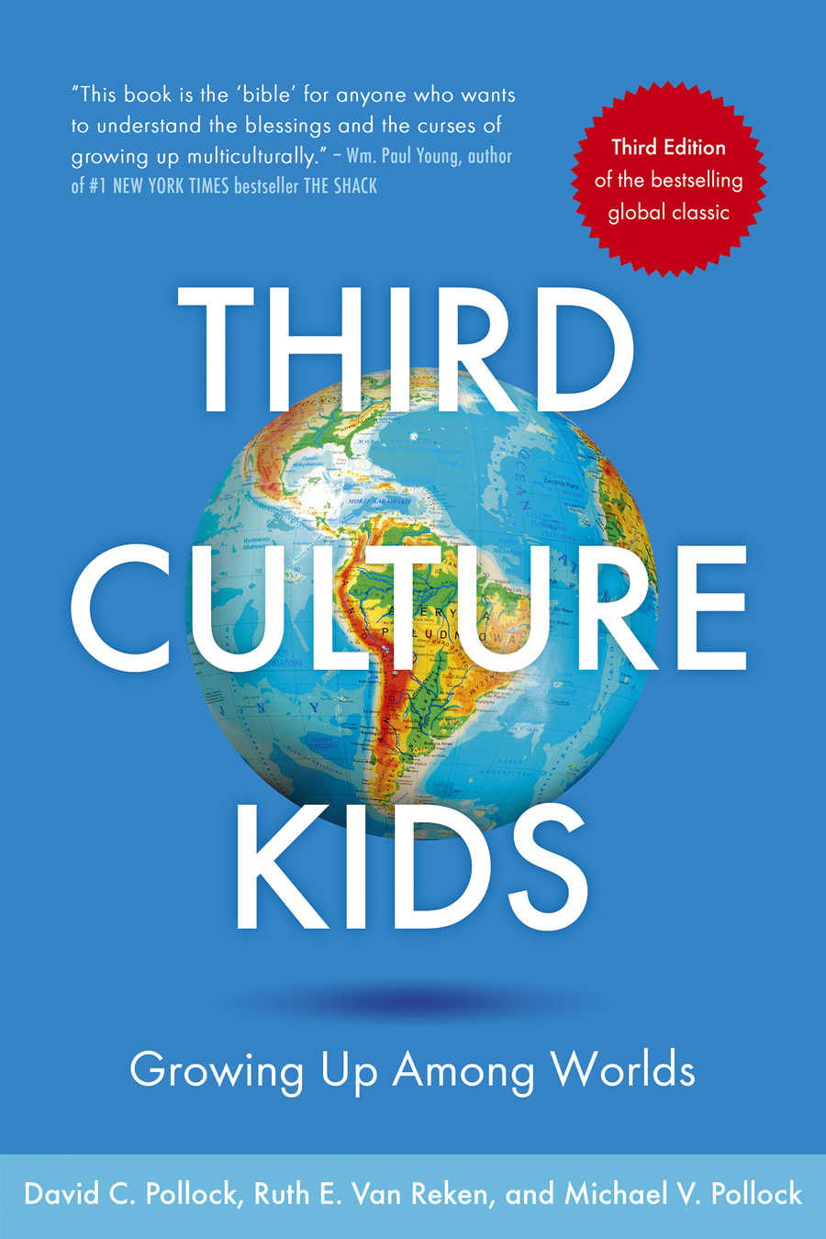
Before we start: What is a TCK or TCA in today’s discussion context?
Who are Third Culture Kids & Third Culture Adults?
An Emergent
3rd Culture
A newly-formed interstitial culture;
an in-between home and host cultures.
A neither/nor world
2nd culture
Host Cultures moved to
Cultures lived in
Egs. America, Nigeria Switzerland, Greece, India, etc)
1st Culture
Home Culture
(Parents’ Culture
Egs. Korea, Japan, Singapore, China, Vietnam)
TCKs: those who navigated significant cross-cultural transitions different from home culture, before 18 yrs old, as children or teens
(adult TCKs – those who moved younger as TCKs but are now older than 18)
TCAs: those who navigated significant cross-cultural transitions different from home culture,
after 18 yrs old, as adults
Third Culture Kids-Growing Up Among Worlds by David C. Pollock, Ruth E. Van Reken, and Michael V. Pollock.
Notes:
1 min

Slide 4
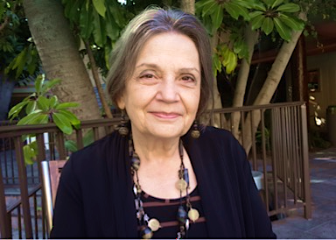
Stories from Ruth… Co-author, Third Culture Kids, Growing up among worlds
Hidden losses refer to unrecognized losses that did not receive healing from proper mourning.
Ruth Van Reken
Notes:
5 min

Slide 5
Why are ‘hidden losses’ important to talk about?
" …It is often nestled within the good of the experience that it isn’t even visible.”
But if the losses are ‘hidden’, the grief is not acknowledged or recognized, it remains unresolved…
Notes:
1 min
Transition statement slide: ..it is invisible, as how Ruth has shown us…
So we want to help talk about it…process it..…in hearing 1) you learn from hearing others’ stories, how they articulate it…name them…you suddnely get deeper understanding of what really lost…what was the loss you grieve about…
(So I. hope we provide a space today…to think about this…some of you jere today are teachers, researchers, counselor, trainer…would like to invite ourselves to be the best helpers by going through the process ourselves.. …in my counseling training…I’ve learned this, We can only bring our clients as far as we have brought ourselves…I always challenge myself to do inner work, to go deeper and further, in the hope that I can help others…)

Slide 6
How do hidden losses come about?
Transitions
Intangible
Changes & Losses
Tangible Changes & Losses
“The reality is that with every transition,
there is loss, even when there is ultimate gain.”
e.g. homes, pets, possessions, friends, money, food, languages…
e.g. status,
lifestyle, identity, independence, comfort, security, freedom,
”access to who you are” when you express yourself in a particular language
It is the meaning attached to what you lost—that is the actual loss…
Notes:
1 min
I would like to suggest why is it so difficult to put a finger to them….
Firstly, in every move, there are tangible and intangible losses… tangible losses are like…bear…,money, furniture, mis the trees from Ruth…for me, I miss my ocean…/being able to see trees and waters easily…drive an hr away to see the ocean… padi that you love….
Intangible – status…career… became a stay-home mum, became a student from career….lifestyle, miss the trees…

Slide 7
Transitions
Intangible
Changes/ Losses
Tangible Changes/ Losses
"The real issue is that in these types of invisible losses, where the tangible and intangible are so inextricably intertwined, no one actually died or was divorced, and nothing was physically stolen. They were all surrounded with so much good." Third Culture Kids-Growing up among worlds, 3rd Edition
Realization:
Reciprocity between tangibles and intangibles
Reciprocity between you and what you miss
Notes:
1 min
So let’s look at why they are so complex…There is this sense of loss or grief but you cannot put a finger to articulate what it was…intertwined…
e.g. tck who collects rocks…hold on to the tangible losses…
Realizaiton: reciprocity….tck shared with me…see padi fields that you grew up in…, yellow flower that grows next to her home..only in korea… melts her heart, touches her soul…reached deep core of who you are…
When I live in the city – I was a different person….When I was here, I was so happy, I was thriving in this school or that context…could express myself in this language, be more funny… but now I couldn’t…
- You miss the parts of yourselves that you cannot access, that doesn’t come out, when you are no longer in those contexts…

Slide 8
Why are the losses ‘hidden’?
Lack of acknowledgement or awareness
No time to think about them in the busyness of transitions…
Distracted by the good stuff
Not acknowledging the loss due to the pain of the loss
Lack of ‘permission’ to talk about losses
“You should be grateful instead…”
(e.g. parents/we want to avoid the “sad stuff” – whether intentionally or unintentionally)
“You haven’t gotten over it?”
(e.g. the loss may not be obvious or impact others in the same way)
Lack of trusted people to share in safety
Perceived cultural inappropriateness
Lack of words to articulate and process the loss…
Notes:
2 min
Perceived cultural inappropriateness…my cultural example
Lack of words therefore, we want to do this today so that we have words to describe this experience we go through
So let’s look at why they are so complex…There is this sense of loss or grief but you cannot put a finger to articulate what it was…

Slide 9
Types of ‘hidden losses’
Loss of relationships
Loss of possessions
Loss of lifestyle
Loss of their world
Loss of a past that was
Loss of ‘what could have been'
Loss of status, identity
Extracted with modifications from Third Culture Kids,s 3rd Edition
Notes:
So let’s talk about the losses…3-5 min talking…
Use my 1 cultural example and build on from there to explain.
1. Loss of relationships…the safe, security you feel when you have close, trusted relationships…don’t feel lonely…miss the safe spaces you have…In school…ppl to eat with, chat with…check hw with…struggles with sch work, feel stupid asking the teacher all the time…
Miss friends, family….2 miss the love, being accepted as who you are…being known…someone who knows you…and you will not be judged…being loved… being safe…
2. Loss of possessions, but it represented a loss of lifestyle and status, identity etc…E.g.……I miss my physical home than my parents…family..…when I move to US for second time, I moved and became a student. Lost your regular income, lived with uncertainty…don’t know if funding will keep coming for 4-5 yrs of phd…live simple home, hand me downs cheap student furniture. No beauty at home, no rest, it represented loss of lifestyle, regular income, freedom & independence, identity of woman of earning power.. and safe space to come back and rest...losses altogether as one. Cultural values did not allow me to acknowledge that... The hidden loss is that …no beauty at home…a mess of mismatched furniture……I should not be materialistic. Values from my culture. I should miss people more than physical home…collectivist culture…it is ‘not right’.. So I did not allow myself to grieve. Safe Space, rest, at home. Til doodle-journaled and suddenly cried for 3 hrs…
(Miss my home physical home, than my parents whom I am still in touch with…felt guilty that I don’t miss ppl but rather, inanimate objects, spaces… I miss having ahome that is decorated, not filled up by some handovers…leftover student furniture…a space I can feel comfortable and love staying home at…).
3. Loss of identity…also a huge one…e.g. cultural identity, work identity… all comes down to ‘mattering’…do you matter?
4. Loss of what could have been… - eg romantic relationships which could have worked out…cos he or she had to move away..or you had to move away…dreams that he or she represented for you…
5. Loss of a past that was…” Lost childhood…couldn’t visit it again…miss the amazon…miss child who climb trees but you cant go back to such climbable trees, or a child who climbs…friends have moved…
6. Loss of a world – Ruth’s example.… World that you love and who you are when you are there, changing colors of the seasons…I miss it so much I call boston my second home…
When you are in one (busy bustling india, noise), you miss the other. When you go back, you miss this new place you grew to love…sometimes, it is so conflicting, but we cannot be in both at the same time…IT is complex, compounded….
So, I’ve shared some stories as an adult or what adult tcks can face, Ruth has shared both from her childhood which extended to adulthood perspective….later, we will hear from our panelists, from you, about stories from growing up…as tcks.
Other examples:
AJ example..crying as she was cooking…loss her career, identity as a woman contributing significantly…instead she had to learn to cook, and be scaleded by oil splatters …she just broke down and cried after 6 mths of relocation into becoming a stay-home mum in America…
navigation compass and familiarity, convenience…left sg to go to boston, take the T…no iphone, no gps. Just by a piece of paper…navigated whole new world…most dangerous neighborhoods to get interview as a counselor intern.

Slide 10
Reflection Questions
What hidden losses have you personally experienced?
What made them hidden for you?
(1 min) If you are comfortable, I would like to invite you:
To type a brief note of your reflection in the chat spaces to share with our community here….
Notes:
1 min, if we have music that’s great…
1 min to introduce and go back to earlier slide and stay there
To Isabelle, Then cue Danau and jane to get ready…

Slide 11
Sharing and Discussion Time
“The reality is that with every transition, there is loss, even when there is ultimate gain.
No matter how much we anticipate the future as good, we almost always leave something of value behind as well. In loss, there is grief. An important thing to remember is that grief during transition is not a negation of the past.”
p. 74, Pollock and Van Reken, 2009
Notes:
6 minutes
Invite Danau (Jap-Indonesian TCK going to international school) to share. Invite one more person to share – would that be Jane (TCK Chinese ethnicity going to public school) Or…
Let ppl see video of the panelist when they are sharing.
1-2 min: Review some chat boxes when they are sharing.

Slide 12
What can we do then?
Acknowledge the losses, be patient with ourselves-both for TCKs & TCAs
Identify them, give yourself permission to articulate the losses experienced
Overcoming obstacles that prevent us from pinpointing our losses, by learning about them, reading, therapy, sharing with a trusted person…
Find/provide safe spaces to process them
Being embracing of the grief of what has changed…
Coping strategies, resources and support network
Be resourceful, reach out
Notes:
30 sec

Slide 13
Resources
https://internationaltherapistdirectory.com/
https://www.tcktraining.com/blog/bringing-your-tcks-hidden-losses-out-of-hiding
Families In Global Transition (FIGT) Conference 2020: https://www.figt.org/;
Facebook groups: TCKs everywhere, Families in Global Transition
More about six different styles of coping strategies: BASIC pH (acronym) is a nice model that Singapore MOE uses, learning from an Israeli center: https://www.lcps.org/cms/lib4/VA01000195/Centricity/Domain/8931/HOW%20CHILDREN%20COPE.pdf
Third Culture Kids: Growing Up Among Worlds, 3rd edition. https://www.amazon.com/Third-Culture-Kids-3rd-Growing/dp/1473657660/ref=sr_1_1?ie=UTF8&qid=1505496203&sr=8-1&keywords=third+culture+kids
Letters Never Sent, updated, 2012, by Summertime Publishing https://www.expatbookshop.com/book/letters-never-sent
www.twitter.com/rdvanreken
www.crossculturalkid.org
www.pinterest.com/amp/heidinindi/tcks-resources-for-third-culture-kids/
Thank you!
Esther C. Tan, linkedin.com/in/esther-tan-49911924, esther.tan@post.harvard.edu
Notes:
30 seconds – 1 min
Some resources, encourage to reach out to those you sense need some resources, be that trusted friend. Just by having someone , a safe space is huge…reach out…interested coping strategies, go to the link , or you can email me…I would be setting up a website, puts in some research made layman, short videos with Ruth…let me know and I can email you when it becomes live in a couple of weeks…

